Slide 1
DATA AND VARIABLES
Data Types(Value Types and Reference Types)
Data Types (Integer, Floating-Point, etc)
Scope, conversion and Casting

Slide 2
VARIABLES
Variables are nothing but reserved memory locations to store values. This means that when you create a variable you reserve some space in memory.
Based on the data type of a variable, the operating system allocates memory and decides what can be stored in the reserved memory. Therefore, by assigning different data types to variables, you can store integers, decimals, or characters in these variables.
There are two data types available in Java:
  Primitive Data Types
  Reference/Object Data Types

Slide 3
VARIABLES(CONT..)
The Java programming language is statically-typed, which means that all variables must first be declared before they can be used.
Before using any variable two steps are involved:
  Declaration:
    type identifier;
  Initialization:
    identifier=value;
In first statement ‘type’ is data type of variable and ‘identifier’ is name of variable, means ‘identifier’ variable will hold value of ‘type’ data type.
In second statement initialization or assignment is performed, the value is assigned to variable named ‘identifier’

Slide 4
IDENTIFIERS
Identifier — an unlimited-length sequence of Unicode letters and digits, beginning with a letter, the dollar sign "$", or the underscore character "_“.
Every programming language has its own set of rules and conventions for the kinds of names that you're allowed to use.
Java Identifiers rules are as follow:
Variable names are case-sensitive
The convention, is to always begin your variable names with a letter
When choosing a name for your variables, use full words instead of cryptic abbreviations.
Java reserved keywords are not allowed to be used as identifier
If your variable stores a constant value than capitalize every word and separate them with underscore, such as
static final int NUM_GEARS = 6

Slide 5
IDENTIFIERS
VALID:
_aName, marks, marksOfJava, marks_Java, Java2
INVALID
    Car>car, %in, 1java
Identifier should not contain spaces: ‘marks of java’
Reserved keyword not allowed: for, int, char, but For, Int, Char
Below given all identifiers are different than each other:
  Java, java, JaVa, jaVa, JAvA, JAVA…

Slide 6
DATA TYPES
Data types defines the range of values a variable can store and associated operations e.g. process and store data.
The primitive types are the boolean type and the numeric types.
The boolean type has the truth values true and false.
Further numeric type is divided into two subcategories: Integer types and floating points.
The integral types are byte, short, int, and long, whose values are 8-bit, 16-bit, 32-bit, and 64-bit signed two's-complement integers, respectively, and char, whose values are 16-bit unsigned integers representing Unicode characters

Slide 7
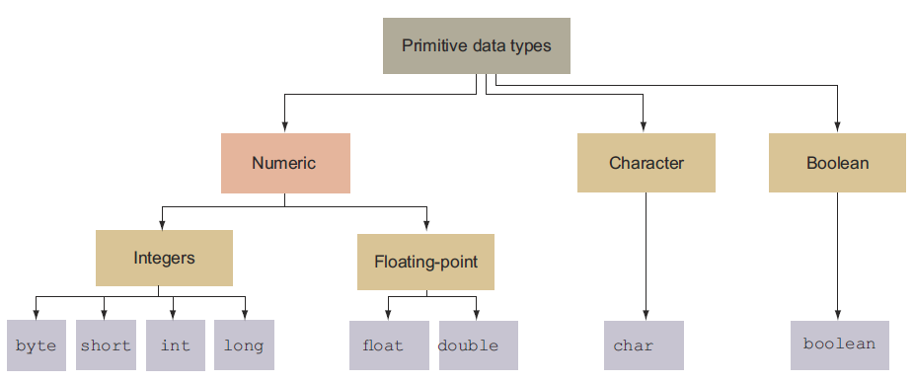
PRIMITIVE DATA TYPES(DIAGRAM AND RANGES)
Data type | Default Value | Size | Range
byte | 0 | 8 bit | -128 to 127
short | 0 | 16 bit | -32,768 to 32,767
int | 0 | 32 bit | -2,147,483,648 to 2,147,483,647
long | 0L | 64 bit | -2⁶³ to 2⁶³-1
float | 0.0f | 32 bit | 1.4E-45 to 3.4028235E+38
double | 0.0d | 64 bit | 439E-324 to 1.7976931348623157E+308
char | '\u0000' | 16 bit | 0 to 2¹⁶-1 or \u0000 to \uFFFF
boolean | false | 1 bit | true and false

Slide 8
CHARACTERS
A char variable stores a single character
Character literals are delimited by single quotes:
'a' 'X' '7' '$' ',' '\n'
Example declarations:
  char topGrade = 'A';
  char terminator = ';', separator = ' ';
Note the distinction between a primitive character variable, which holds only one character, and a String object, which can hold multiple characters

Slide 9
REFERENCE TYPES, OBJECTS, AND REFERENCE VALUES
An object is a dynamically created class instance or an array
The Class String
  Instances of class String represent sequences of Unicode characters
  A String object has a constant, unchanging value. String literals are references to instances of class String.

Slide 10
IDENTITY CONVERSIONS
A conversion from a type to that same type is permitted for any type.
Widening Primitive Conversions
The following conversions on primitive types are called the widening primitive conversions i-e do not lose information about the sign or order of magnitude of a numeric value:
byte to short, int, long, float, or double
short to int, long, float, or double
char to int, long, float, or double
int to long, float, or double
long to float or double
float to double

Slide 11
NARROWING PRIMITIVE CONVERSIONS
The following conversions on primitive types are called narrowing primitive conversions and may cause data loss:
byte to char
short to byte or char
char to byte or short
int to byte, short, or char
long to byte, short, char, or int
float to byte, short, char, int, or long
double to byte, short, char, int, long, or float

Slide 12
SCOPE OF VARIABLES
The Java programming language defines the following kinds of variables:
Instance Variables (Non-Static Fields):
Class Variables (Static Fields)
Local Variables
Parameters

Slide 13
ESCAPE SEQUENCES
Some Java escape sequences:
Escape Sequence
\b
\t
\n
\r
\"
\'
\\
Meaning
backspace
tab
newline
carriage return
double quote
single quote
backslash

